Slide 1
COMPUTER ORGANIZATION AND ARCHITECTURE
Dr. Rizwan Khan
Head – Department of Computer Science and Engineering
(An NBA Accredited Program)
ABES Institute of Technology, Ghaziabad

Slide 2
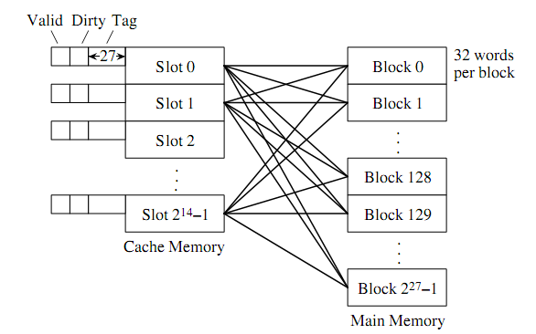
Fully Associative Mapping
An incoming main memory block can be placed in any available cache block.
This mapping does not impose any restriction on the placement of blocks in cache memory.
This offers maximum flexibility

Slide 3
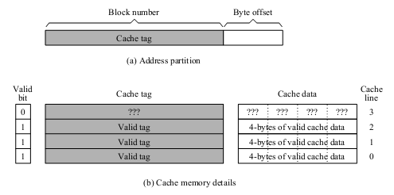
Fully Associative Mapping
With associative mapping, we divide the address into two components :
The least significant bits are used for byte offset as in the direct mapping scheme, if Block size is B bytes;
The remaining bits are used as the tag field.

Slide 4
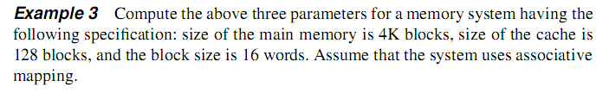
Example
B = Block Size = 16 words
C = Cache Size = 128 Blocks
M = Main Memory Size = 4K Blocks
Main Memory Address length = log ₂ (4Kx16) = 12 bits
Byte Offset b = log ₂ B = log ₂ 16 = log ₂ 2⁴ = 4 bits
Tag Bits t = Remaining Higher order bits = 16 – 4 = 12 bits

Slide 5
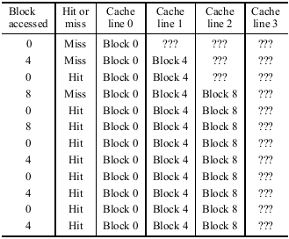
Hit Ratio
Example : Consider the reference pattern of Previous Example that accesses the sequence of blocks 0, 4, 0, 8, 0, 8, 0, 4, 0, 4, 0, 4. Assuming that the cache uses associative mapping, find the hit ratio with a cache size of four cache lines.
In fully associative mapping, the incoming block can take any free cache line, we use a FIFO allocation. Block 0 is placed in cache line 0, block 4 is placed in the next available cache line, and so on. Thus, after three misses to load the blocks 0, 4, and8 initially, the remaining nine references can be read from the cache. This gives us a hit ratio of 75%. This is in contrast to the hit ratio of 0% obtained with direct mapping. Because these three misses are compulsory misses, this is the highest hit ratio we can get for this reference pattern.

Slide 6
Disadvantages
The major drawback is the location of a block in the cache.
Since a block can be in any cache line, we have to search all tag fields in parallel to locate a block. This means we need hardware to do 2^{c} comparisons, where c is the number of cache lines.

Slide 7
Set Associative Mapping
Set-associative mapping is a compromise between direct and associative mapping. It divides the cache lines into disjoint sets. Mapping of a memory block is done as in direct mapping, except that it maps the block to a set of cache lines rather than to a single cache line. The block can be placed in any cache line within the assigned set as in the associative mapping. Set-associative mapping reduces the search complexity to the number of cache lines within a set. Typically, small set sizes—2, 4, or 8— are used.

Slide 8
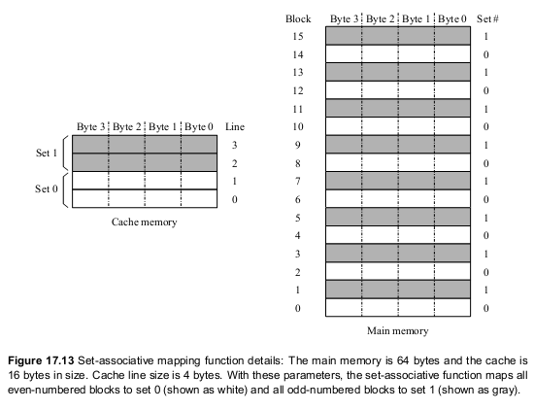

Slide 9
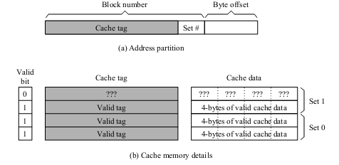
Set Associative Mapping
Set-associative mapping partitions the address into three components :
• The least significant bits b specify the byte offset as in the other two mapping functions.
• The next s bits identify a set. The number of bits for the s field is given by s = log ₂ S where S is the number of sets
The remaining higher-order bits are used as the tag, as in the other two mappings.

Slide 10
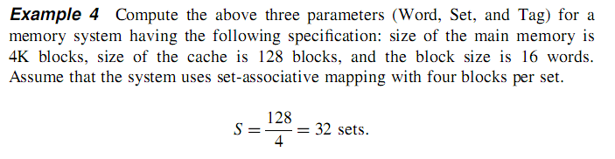
Example
B = Block Size = 16 words
C = Cache Size = 128 Blocks
M = Main Memory Size = 4K Blocks
Main Memory Address length = log ₂ (4Kx16) = 12 bits
Byte Offset b = log ₂ B = log ₂ 16 = log ₂ 2⁴ = 4 bits
Set Field s = log ₂ S = log ₂ 32 = log ₂ 2⁵ = 5 bits
Tag Bits t = Remaining Higher order bits = 16 – (4+5) = 7 bits

Slide 11
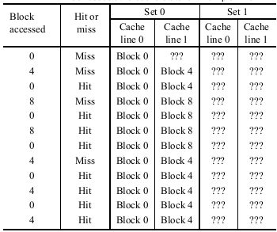
HIT RATIO
Let us consider the reference pattern that accesses the sequence of blocks 0, 4, 0, 8, 0, 8, 0, 4, 0, 4, 0, 4. Assuming that the set size is 2 AND cache size of four cache lines.
Since the cache size is four lines and the set size is 2, we have two sets. Therefore, all blocks with an even number are mapped to set 0, and odd numbered blocks to set 1. In the example, all three blocks—0, 4, and 8—are mapped to set 0. The first reference to block 8 presents an interesting situation. This even-numbered block is mapped to set 0. However, set 0 is full (with blocks 0 and 4). Now we need to make decision as to which block should be replaced. This is determined by the replacement policy in effect. We use LRU. Between blocks 0 and 4, block 0 has been accessed more recently. Thus, we replace block 4 with block 8. A similar situation arises when block 4 is accessed later. Using set-associative mapping gives us 8/12 67% as the hit ratio. As you can see, this hit ratio is better than that of the direct-mapped cache but lower than that of the fully associative-mapped cache.

Slide 12


